Slide 1


Credit Card Classification
Metis Project 3 (Supervised Learning)
Gabriel Equitz
Winter Cohort 2021
February 10, 2021

Slide 2
Project Idea
A credit card startup is developing a supervised learning model for issuing credit cards, and want to filter out applicants likely to default.
The model will collect data from credit card applicants to predict the probability of future defaults, credit card borrowings.

Slide 3

Why?
Important as cash is becoming
less common, and less accepted
Int’l market growing
From $205.45 billion in 2019 to $212.23 billion in 2020 (CAGR=3.3%)
Prevent either of us falling into debt

Slide 4
Target/Metric
Target: Credit Card Default (Y/N)
Metric: Accuracy
Dataset is balanced (comprehensive data from April-September)
Number of credit cards rejected is not insignificant
Notes:
Accuracy is the number of correctly predicted data points out of all the data points.
More formally, it is defined as the number of true positives and true negatives divided by the number of true positives, true negatives, false positives, and false negatives.

Slide 5
Data Description
- The project contains 1 csv file*
- UCI_Credit_Card.csv contains 30,000 rows and 25 columns, containing features such as Gender, Completed High School, Marriage Status, and Pay/Balance
*UCI data via Kaggle.com

Slide 6
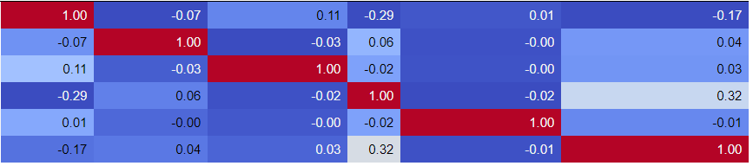
EDA
First get data, followed by data cleaning
Started with 24 features, narrowed it down to 6
Lack of correlation among features
Notes:
REMEMBER AUDIENCE

Slide 7
Features
Gender (males more likely to default)
University (+)
High School (+)
Married (less likely to default than Single)
Pay_0 (Repayment status in September, 2005)
Bill/Credit (average monthly bill over credit)

Slide 8
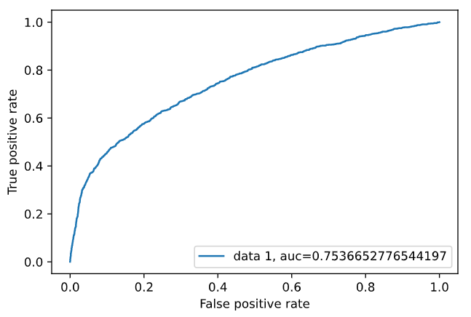
Models
XGBoost: Accuracy: 0.818
Precision: 0.6896
Recall: 0.3303
AuC = 0.7536

Slide 9
Models Compared
 | Accuracy | Precision | Recall | AuC
XGBoost | 0.818 | 0.689 | 0.330 | 0.753
Log. Regression | 0.803 | 0.691 | 0.208 | 0.716
Naive Bayes | 0.226 | 0.222 | 0.994 | 0.732
Random Forest | 0.771 | 0.479 | 0.343 | 0.682
KNN | 0.818 | 0.690 | 0.330 | 0.749

Slide 10
Conclusions
The best model out of the 5 is XGBoost
Accuracy = 0.818
AuC = 0.754
Based on our dataset, we use Gender, University, High School, Married, Pay_0, Bill/Credit for features.

Slide 11
End Statement
Because of this model, our credit card startup will be able to issue credit cards prudently, minimizing risk of default, which shelters us and users from financial losses
Kaggle notebook: https://www.kaggle.com/uciml/default-of-credit-card-clients-dataset
Project 3 SQL: 4 SQL Challenges are completed on my GitHub

